Slide 1
Sensor Pod Configuration at TFRI with PRIME Week 6
Thaddeus Trinh
August 7, 2013

Slide 2
Proposed Research
To work with TFRI to help integrate new sensors into their Android sensor pod network and to deploy and test the new sensors in the field
Fuel Moisture Sensor
Solar Irradiation Sensor
Soil Moisture Sensor
Soil Drainage Gauge

Slide 3
Progress (Week 6)
Waiting on the LT1168 Resistance to Voltage reader for the Fuel Moisture Sensor
Skype call with Peter Shin for troubleshooting the CTD SDI-12 communication protocol

Slide 4
CTD and Fuel Moisture Sensor
There are still many connectivity issues with CTD
SDI-12 to RS232 Translator communicates with computer, but not with RS232 shifter on Android Sensor Board
Sensor does not communicate in either setup, could be due to power issues, but is unknown, may try testing with another SDI-12 sensor
Fuel Moisture Sensor
Code is complete and ready
Waiting for LT1168 to read the Fuel Stick Temperature which is needed in unison with the Fuel Stick Humidity to calculate Fuel Stick Moisture

Slide 5
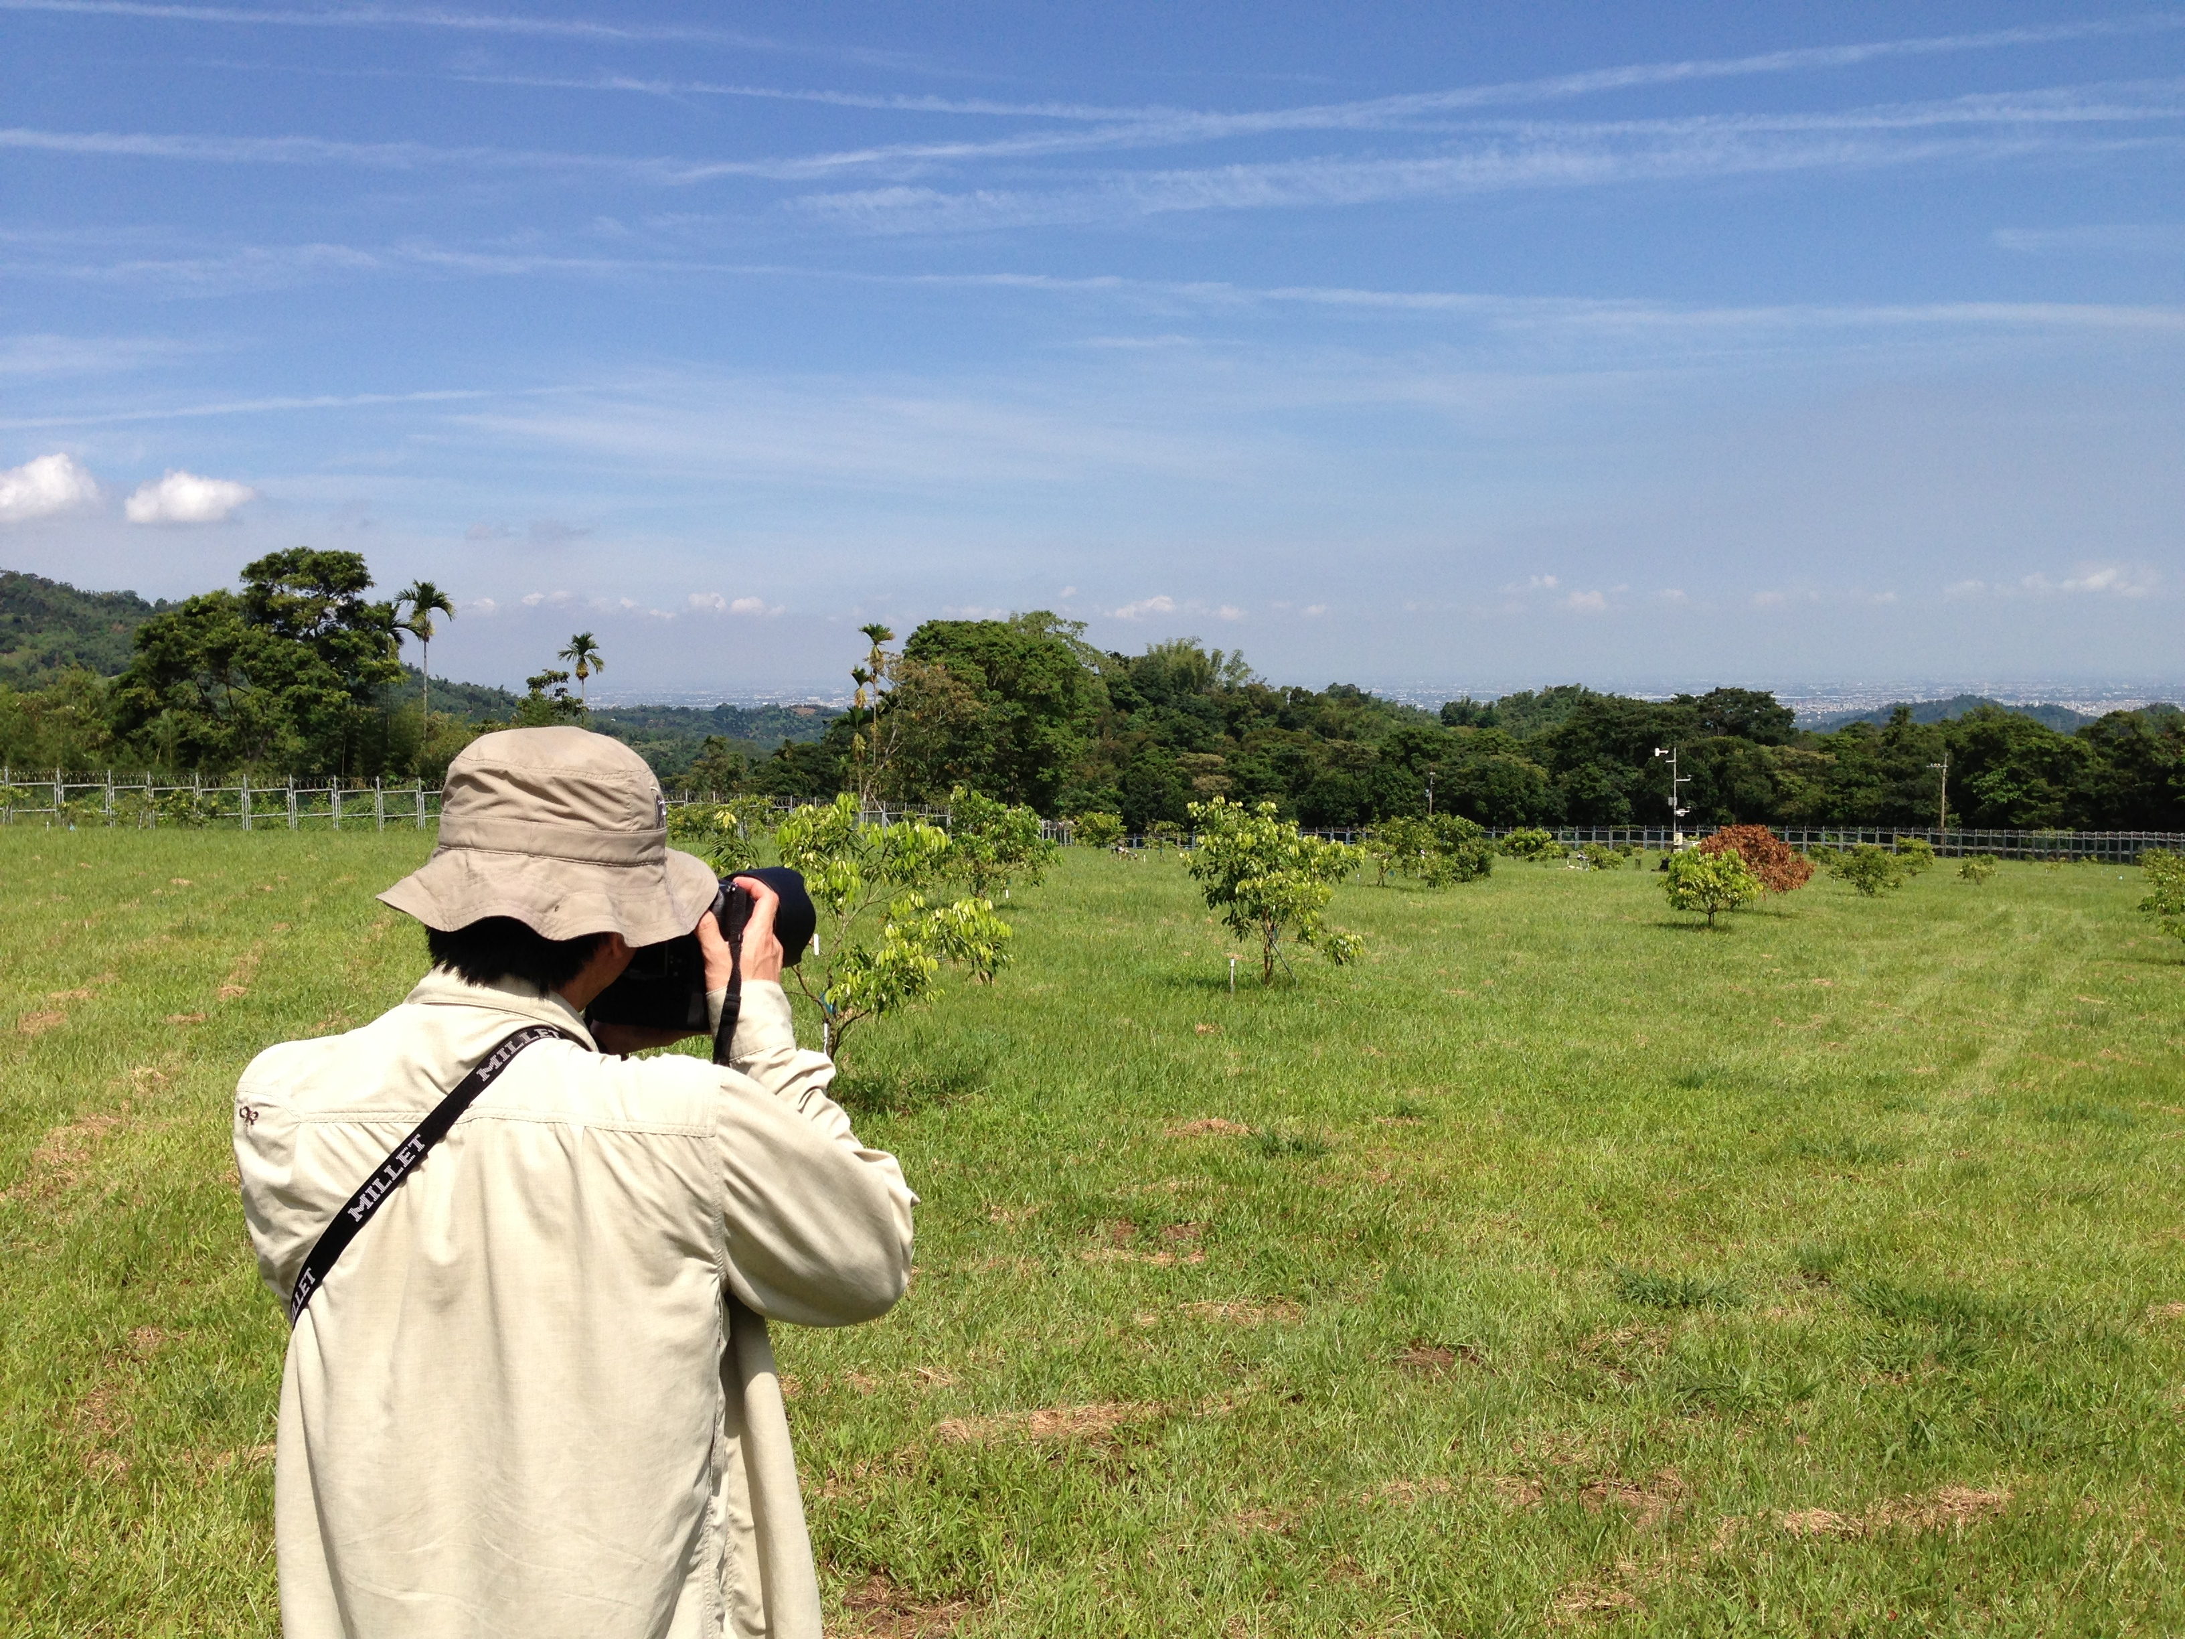

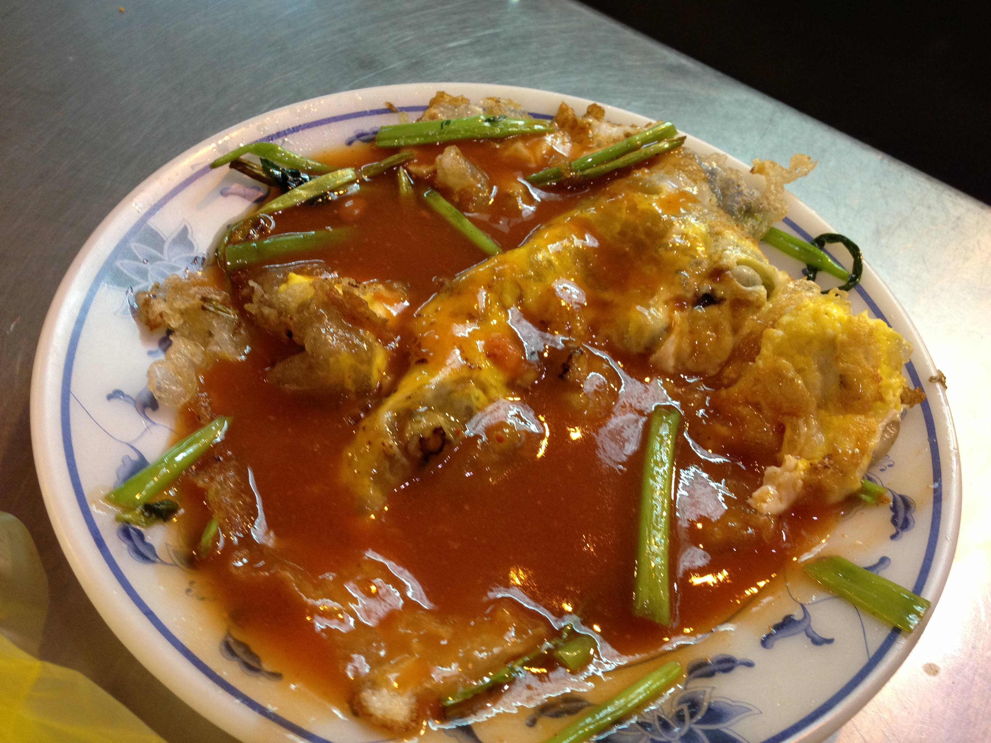
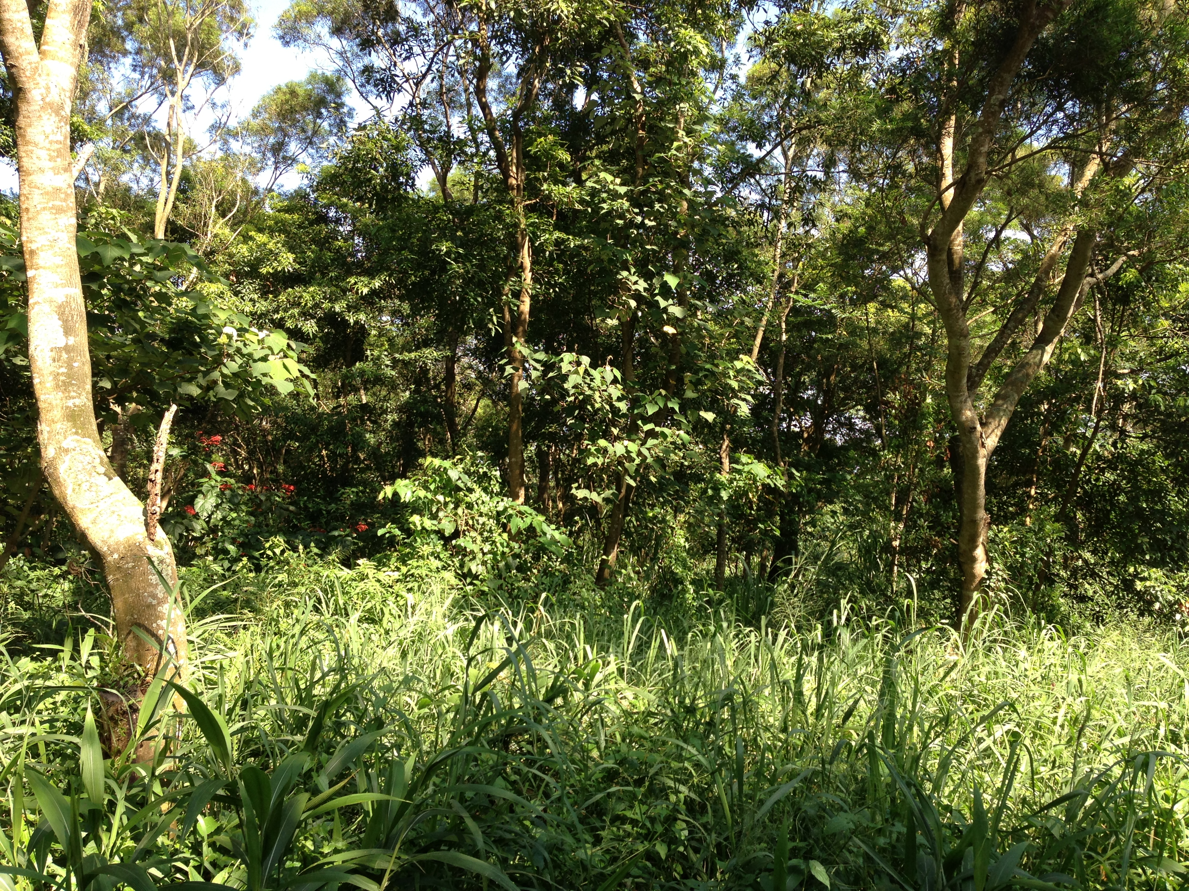
Culture

Slide 6
Acknowledgements
Mentors
Tony Fountain (CALIT2)
Chau Chin Lin (TFRI)
Sheng-Shan Lu (TFRI)
Yu-Huang Wang (TFRI)
Peter Shin (CALIT2)
PRIME
Peter Arzberger
Gabriele Wienhausen
Teri Simas
Tricia Taylor

